Slide 1

Glove Drummer
MIDI Controller and Audio Playback System
Group 15:
Aaron Rice (EE)
Timothy Cox (CpE)
Michael Moran (EE)

Slide 2
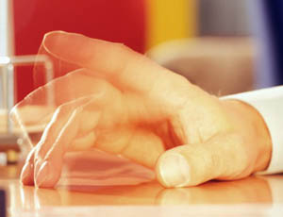
Motivation
Urge to tap hands or fingers along to music
To intuitively map a drum set to different parts of the hand
To shrink to size of an electronic drum kit, allowing drummers to practice almost anywhere

Slide 3
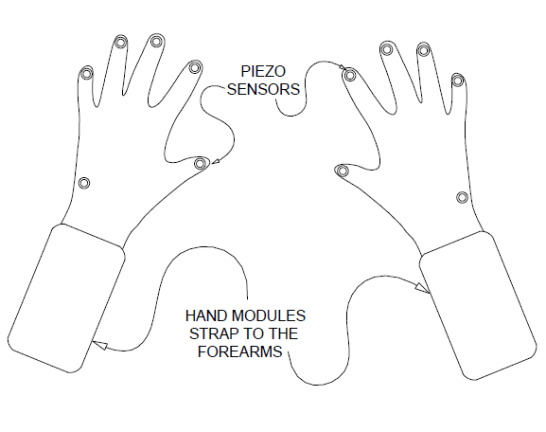
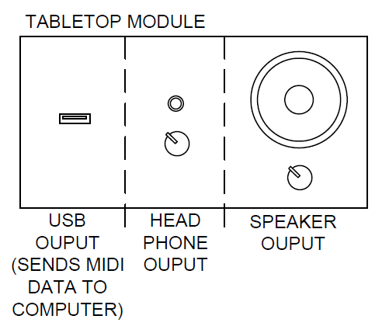
High Level View

Slide 4
Specifications
Hand Module
Must not weigh over 2 lbs since secured to wrist
Provide stable 3.3V and 5V supply rails from a li ion battery
Must use a sensor which can create an analog electrical signal from the tapping of a finger.
Sensor output must be proportional to the energy contained in the strike of the finger
Tabletop Module
Play audio files with less than 15ms of latency between sensor input and audio output
Have a standard 3.5mm headphone jack for solo playing
Produce CD quality sound, 16 bit resolution at a 44.1kHz sample rate
Contains at least five different velocity samples for each drum

Slide 5
Requirements
Hand Module
PCB must be kept as small as possible
MIDI messages should be sent wirelessly if a small enough PCB can be achieved
Tabletop Module
Fit on a standard desk or table
Receive input from hand and pedal modules
Mix audio files without changing total volume
Playback audio through onboard speaker
Utilize interchangeable SD card for audio file storage
Utilize MIDI messaging to interact with existing digital audio workstation (DAW) software

Slide 6
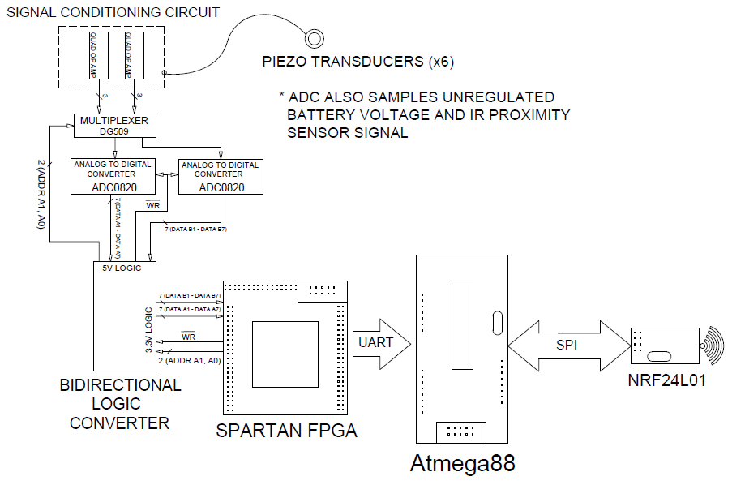
Inside the Hand Modules

Slide 7
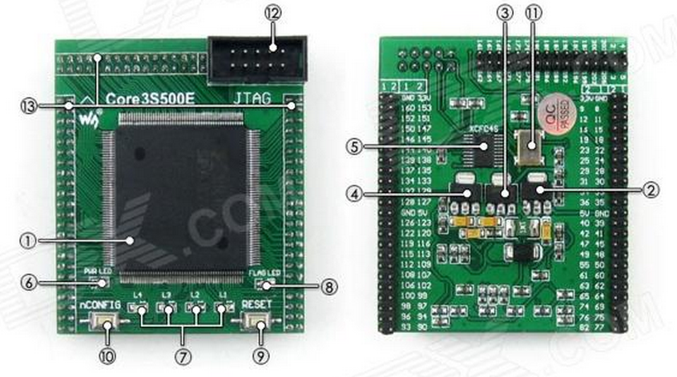
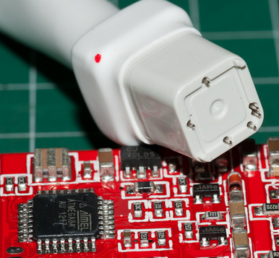
Hand Module FPGA and MCU
Spartan FPGA XC3S500e dev board
  $35 on eBay
  made to be plugged into another PCB
Wireless prototyping components
  ATmega88 dev boards (x2), nRF modules (x2), USBasp programmer all obtained from eBay for a total cost less than $20
  ATmega88 QFP-32 to be used on PCB and programmed with a special QFP adapter for the USBasp

Slide 8
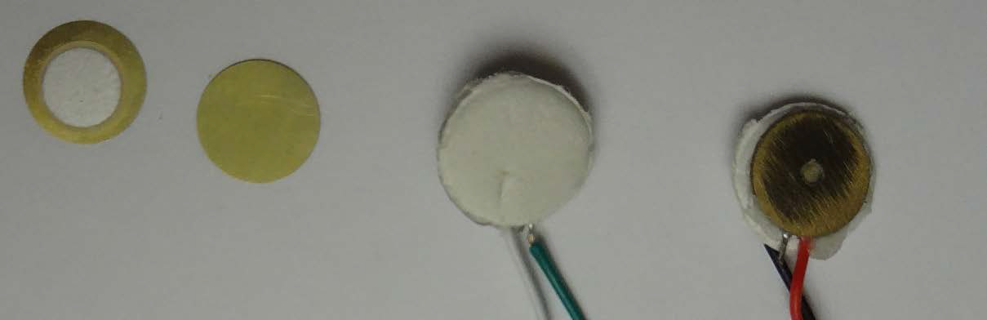
Piezoelectric Sensors
Reinforced by foam and brass disks (diameter = 1cm)
Soldered carefully with respect to Curie Temperature

Slide 9
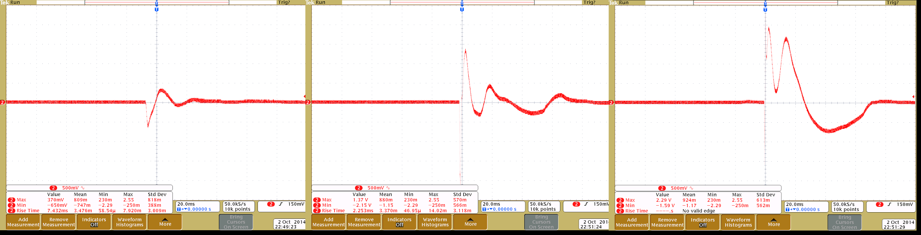
The Piezo Signal
Magnitude of voltage response is proportional to how hard the sensor is struck

Slide 10
Signal Conditioning
High output impedance of the piezo is a concern
Signal must be bound between zero and 5V in order to interface with the ADC0820
Bandpass filter centered around piezo’s resonant frequency reduces noise

Slide 11
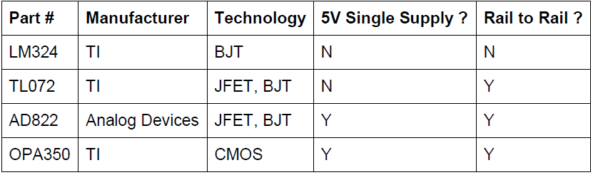
Selecting an Op Amp
Large selection of free samples
Cost not a major factor in decision, in contrast to ADC

Slide 12
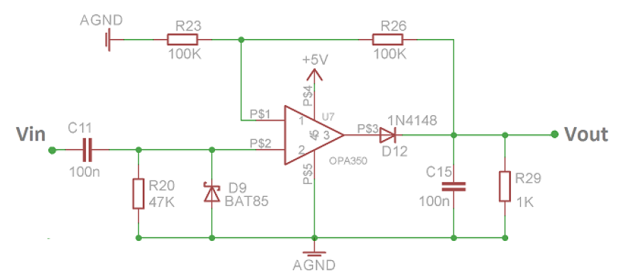
The Conditioning Circuit

Slide 13
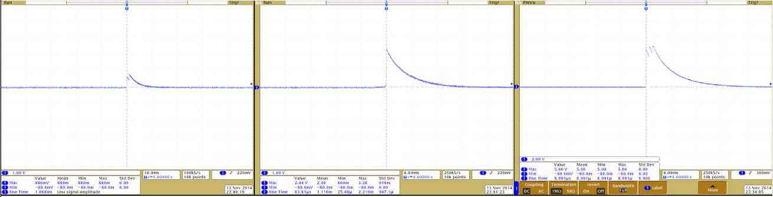
The Conditioned Signal
Signal rapidly peaks and then dies out long before the finger has another chance to tap the sensor

Slide 14
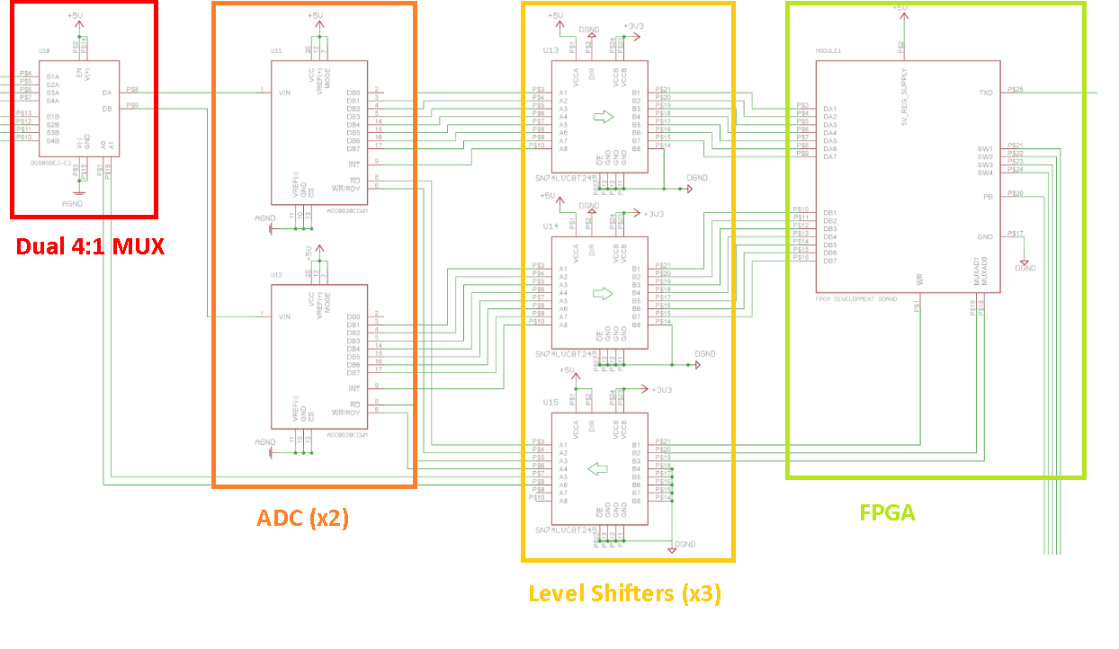
Acquiring Sensor Data

Slide 15
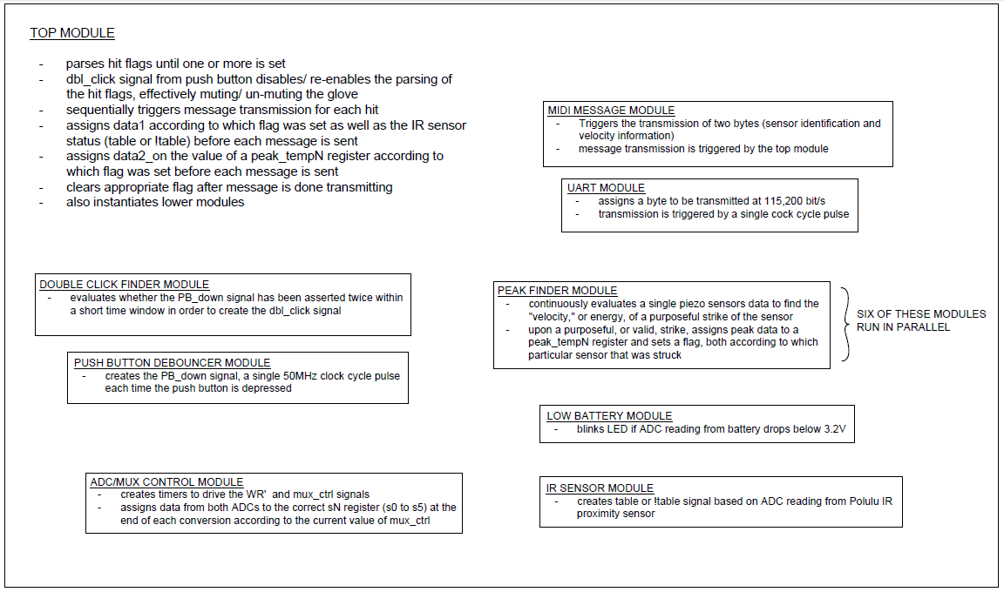
Verilog Modules

Slide 16
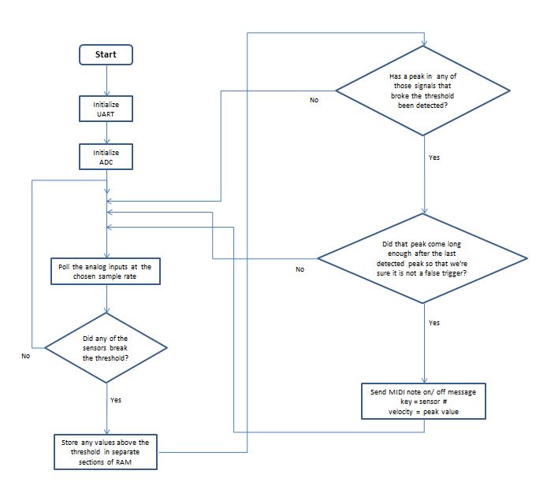
Finding Hits
State Machine waits ~1ms after threshold is surpassed to send hit message and another ~30ms before beginning to look for a new hit or peak
Using an FPGA allows each piezo to have two dedicated hardware timers for this purpose

Slide 17
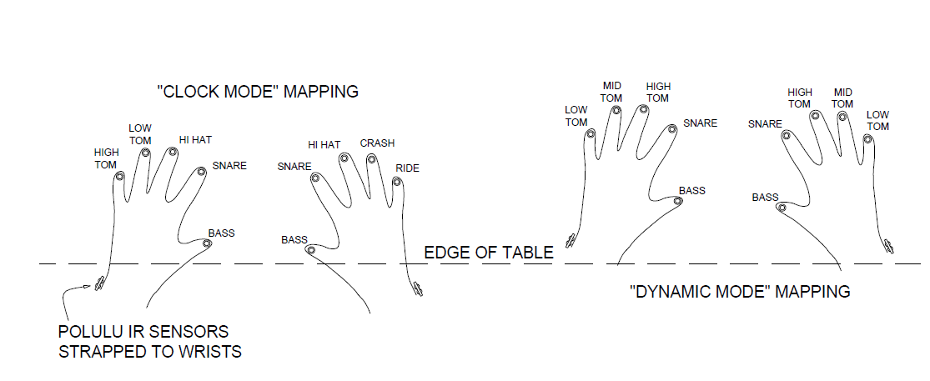
Drum Fills
Can’t bounce the fingers like a drumstick on a skin
Can change mapping sensor to drum mapping with the help of a Polulu IR sensor
More or less two discrete outputs

Slide 18
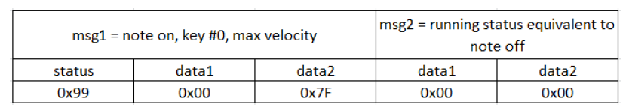
Transmitting Hit Information
Only need to transmit two bytes per hit
  byte #1 = data1 = sensor identification
  byte #2 = data2 = velocity
Compare # of bytes to MIDI running status

Slide 19
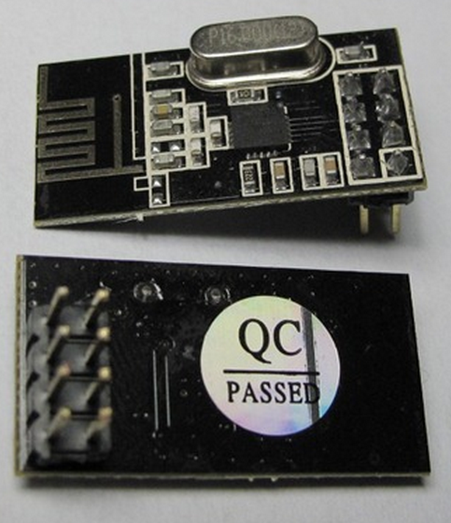
nRF24L01 Transceiver
Uses 2.4 GHz ISM band
Less than $2 per unit on eBay
2 Mbps transmission speed
SPI MCU interface
approximately 1.5” x .75”

Slide 20
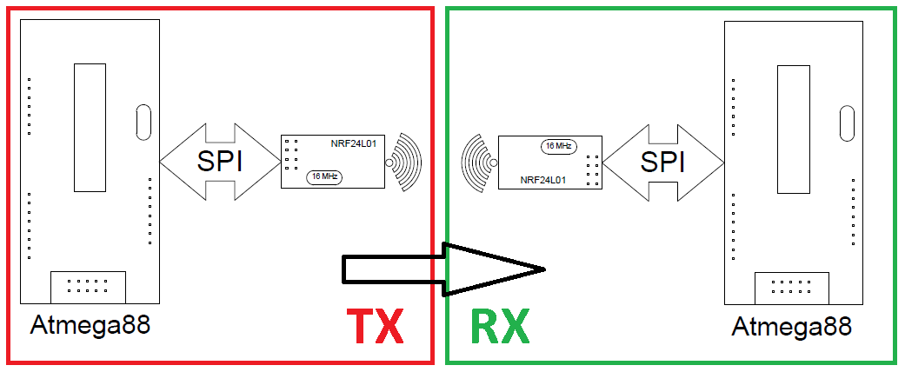
nRF24l01 C Library
Provides layer of abstraction to nRF hardware
Transmit_payload() sends two bytes to receiving unit
In receiving unit, nRF sends interrupt signal to the MCU, telling it a message has been received from the hand module
Can check if transmission was successful and retry as needed

Slide 21
Powering The Hand Modules
Should use readily available, rechargeable Li-Ion batteries
Will need to provide both 5V and 3.3V power rails
Low battery indicator LED will alert user when to change the battery
Battery will be easily swapped when needed

Slide 22

18650 Li-Ion Batteries
Over-charge, over-discharge, and thermal protection from onboard IC
3.6V or 3.7V advertised nominal voltage
4.2V fully charged, 3.0V fully discharged
reported 2800 mAh actual capacity
$10 for two from eBay, with a charger
~25% bigger than AA battery

Slide 23
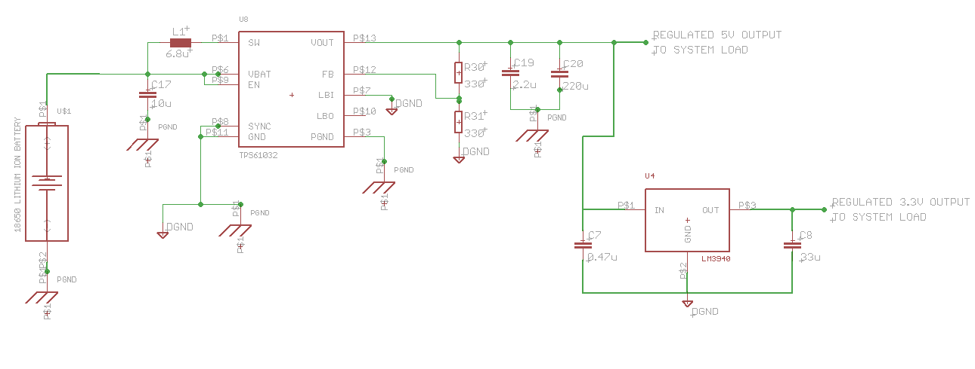
TPS61032
DC to DC boost switching regulator, up to 2A capability
creates 5V supply rail regardless of the 18650 battery voltage
3.3V parts are then powered from LM3940 LDO IC

Slide 24

Hand Module PCB
Must fit inside one of a few chosen clear enclosures
Uses mostly 1206 (1.6mm x 3.2mm) or larger SMD components
Does not use any “no leads” packages for fear of unseen solder bridges
FPGA and nRF24l01 boards will plug into Hand Module PCB through female headers
ATmega88, DG509, OPA4350 (x2), ADC0820 (x2), SN74LVC245 (x3), TPS61032, and LM3940 ICs will be reflowed onto PCB using a heat gun and solder paste.

Slide 25
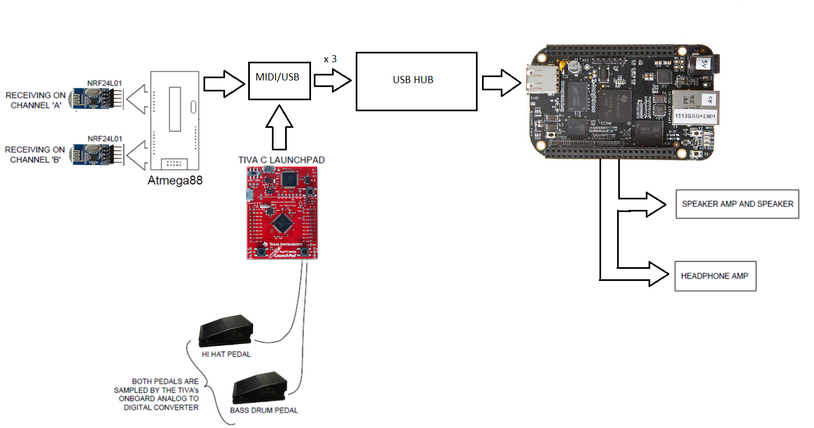
Inside the Tabletop Module

Slide 26
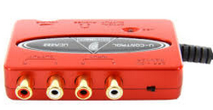
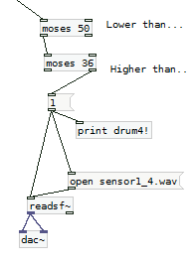
Why we chose to use the BeagleBone
Open source FAT file system for SD cards has not been
optimized for real time audio mixing.
BBB is cheaper than the MCU alternatives with SDMC and a 16 bit DAC
Beaglebone can connect with a USB sound card to easily produce CD quality audio
Allowed us to use PureData visual programming to
configure the .wav file triggering and mixing

Slide 27
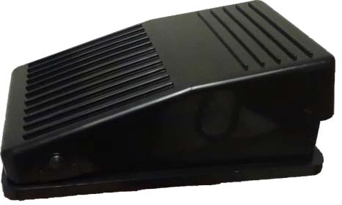
The Bass Drum Pedal
Piezo sensor glued to bottom of pedal housing is struck by plastic angle bracket mounted to top of housing when pedal is depressed
Velocity determined similarly to in the hand modules except code is written in C

Slide 28
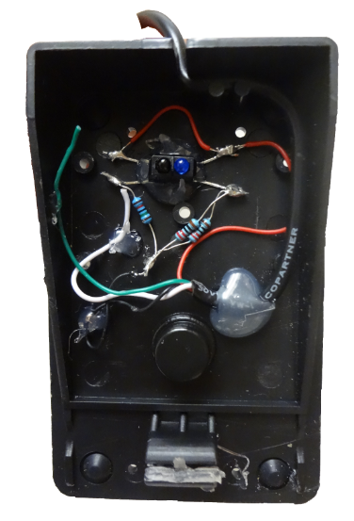
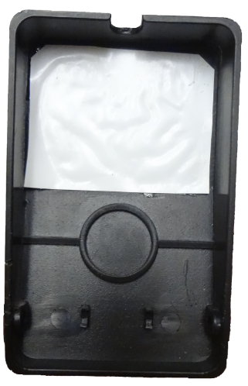
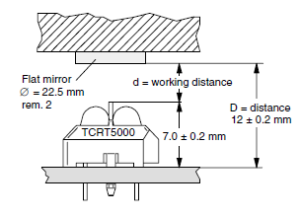
The Hi Hat Pedal
Uses TCRT5000 IR Proximity sensor
2.0V output fully depressed, 0V output when pedal is open
linear response from 0 to 2V

Slide 29
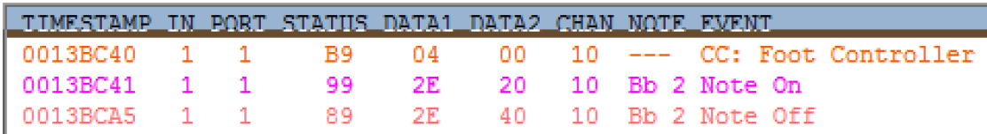
Hitting the Hi Hat Cymbal
if(hi hat cymbal hit)
{send pedal position before hit info}

Slide 30
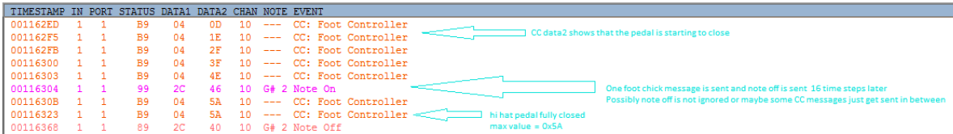
The “Foot Chick” Sound
Closing the pedal quickly creates the “foot chick” sound

Slide 31
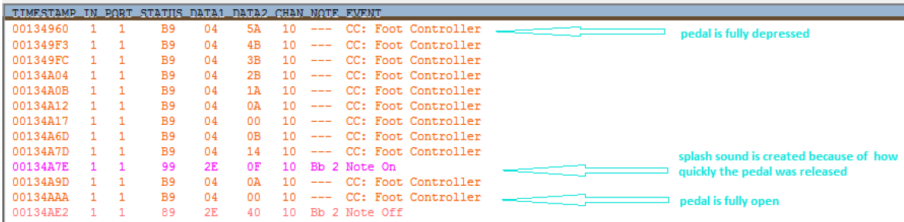
The “Foot Splash” Sound
Opening the pedal quickly creates the “foot splash” sound

Slide 32
Creating MIDI Messages
Must combine data from four sources
  Left Hand Module: hit info
  Right Hand Module: hit info
  Bass Drum Pedal signal: hit info
  Hi Hat Pedal: position, chick, and splash info
MIDI output will include all the data necessary to create most sounds an acoustic set can make

Slide 33
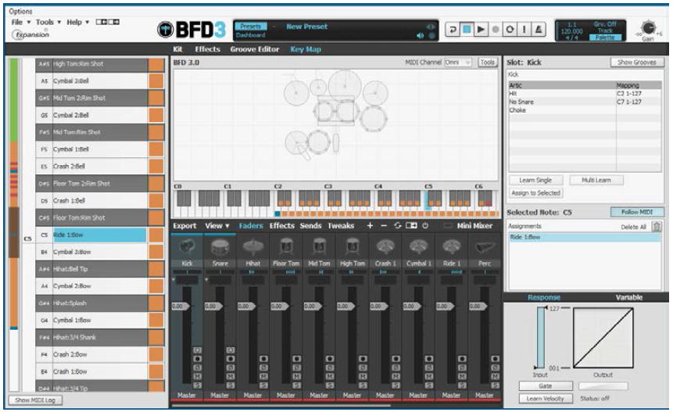
Glove Drummer and BFD3
BFD3 software has been designed for electronic drum kits and will nicely with Glove Drummer
Allows for flexible mapping from sensor to drum inside of BFD3 or other drum software

Slide 34
Onboard Audio Playback
BeagleBone Black will be interfaced to UCA-222 USB soundcard to support low latency polyphonic audio playback
16 bit 44,100 Hz *.wav files stored in onboard microSD
Users can load their own sounds to the microSD from their computer

Slide 35

Audio Files
Each drum or cymbal will have many different sounds stored on the Beaglebone’s onboard microSD card
Velocity determines which sound is added to the mix
In the case of a hi-hat hit, both pedal position and velocity determine the appropriate sound to play

Slide 36
Polyphony
Multiple sounds will need to be played through the speaker simultaneously
Individual samples must be added together without clipping
  Levels of the each audio file were tested to ensure that when mixed, no distortion occurred

Slide 37
The Speaker Enclosure
Includes speakers and speaker amp
The transformer and rectifier were replaced by laptop power supply to create space for circuitry
Linear Voltage Regulators will be used to power the 5V and 3.3V parts

Slide 38
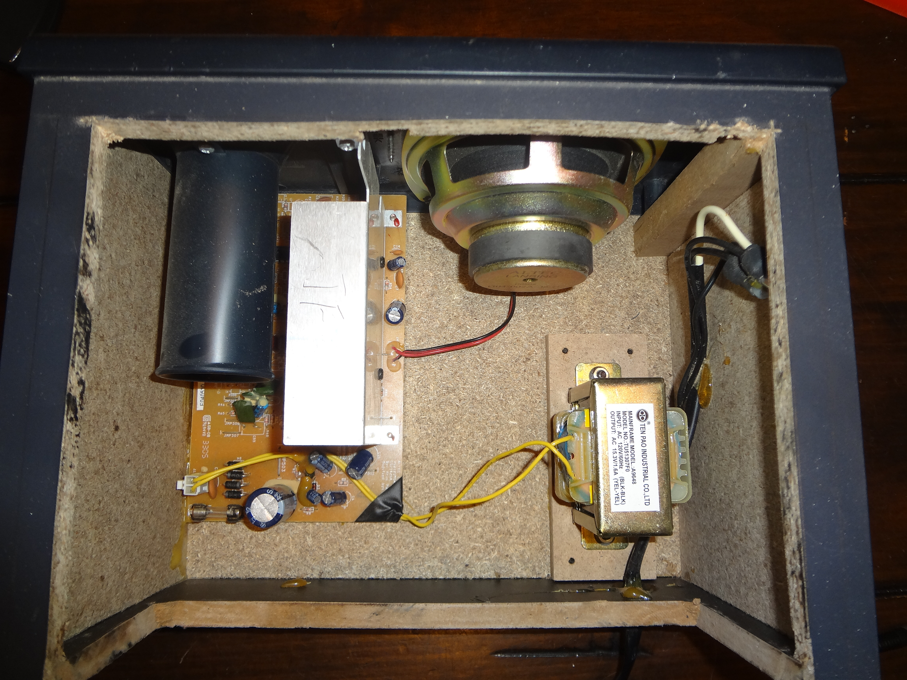
The Speaker Enclosure

Slide 39
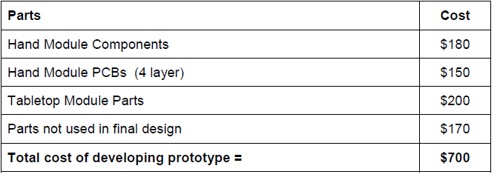
Projected Budget

Slide 40
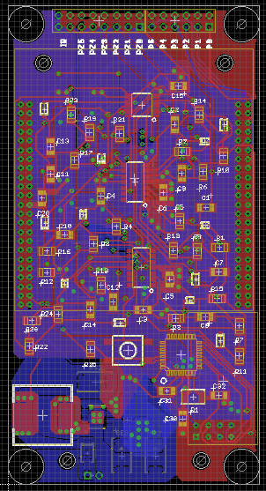
Challenges
Pin assignment errors when creating our Eagle library lead to hours of scratching out traces then point to point soldering SOIC parts
Yesterday
  8:00 AM… Finally fixed all errors, sent MIDI messages!
  12:00 PM… Wireless message relaying almost working
  5:00 PM… Magic blue smoke, broken bass pedal

Slide 41
Proposal for Completion
Implement the hand module design point to point soldered on Perfboard, this will replace our faulty PCB
Since the PCB will be much larger than intended, the hand module will now be “wired”
We would like to make a short video of this new circuit working correctly and email it you to prove our Verilog coding and circuit design does function correctly.

Slide 42
Proposed Perfboard Circuit

Slide 43
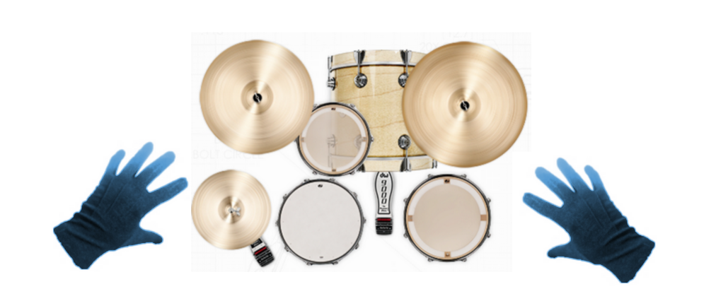
Questions?

